Slide 1
Partial differential equation
Doan Tung Anh

Slide 2
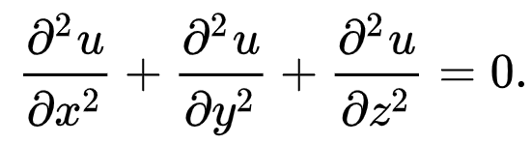
Partial differential equation (PDE):
relations between the
various partial derivatives of a multivariable function.

Slide 3
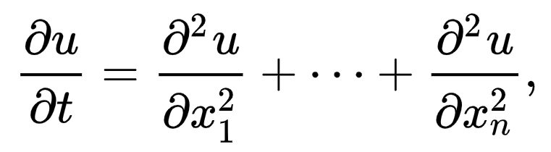
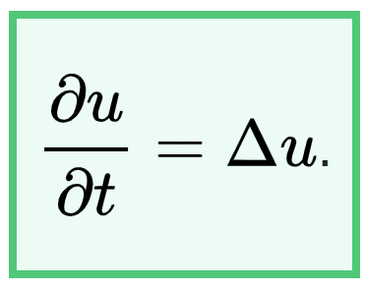
Heat equation
how a quantity such as heat diffuses through a given region

Slide 4
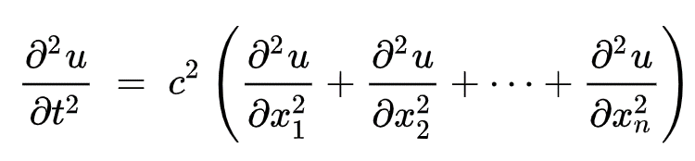
Wave equation
how a quantity such as heat diffuses through a given region

Slide 5
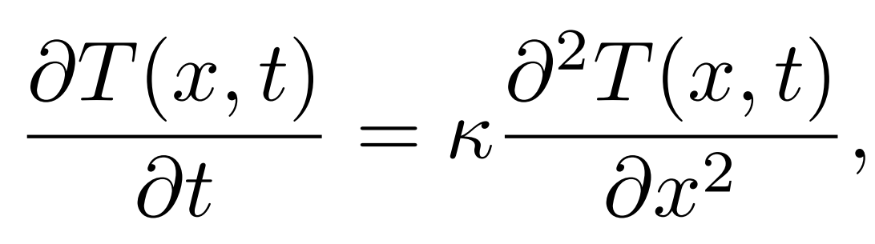
We cover the heat equation as example:

Slide 6
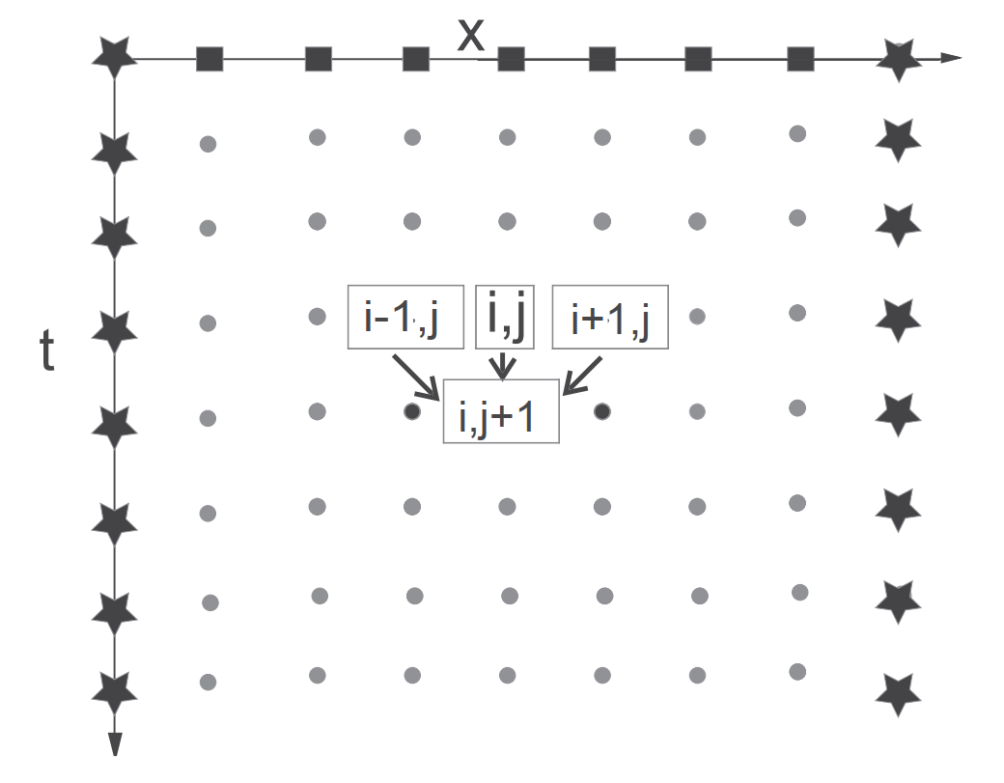
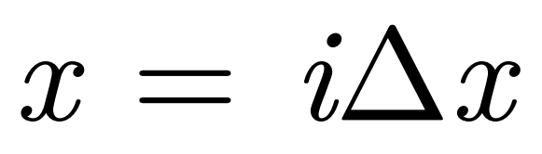
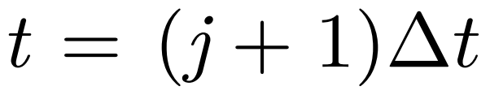
the temperature at the location
and time
is computed from the temperature values at three points of an earlier time.
The solid boxed nodes on top correspond to the known initial condition,
while the starred nodes correspond to the unchanging boundary conditions.

Slide 7
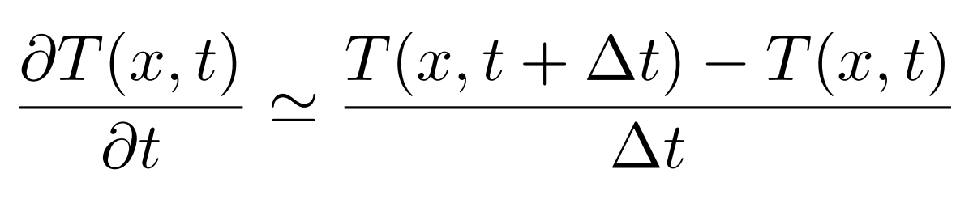
The finite difference technique discretizes space and time on a lattice
we know the spatial dependence of the solution at t = 0, we use a forward-difference approximation for the time derivative incorporating the initial solution:

Slide 8
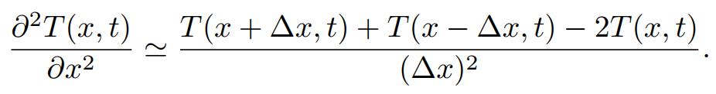
Because the boundary conditions provide the spatial variation of the temperature along the entire top row and the left and right sides, we can use the more accurate central-difference approximation for the space derivative.

Slide 9
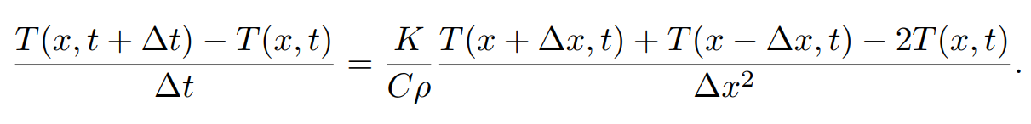
Because the boundary conditions provide the spatial variation of the temperature along the entire top row and the left and right sides, we can use the more accurate central-difference approximation for the space derivative.

Slide 10
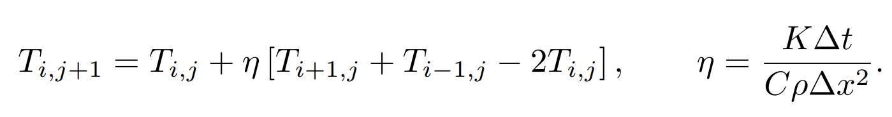
Because the boundary conditions provide the spatial variation of the temperature along the entire top row and the left and right sides, we can use the more accurate central-difference approximation for the space derivative.
3. Reorder into the form of an algorithm in which T can be stepped forward in time t = j∆t for all of space x = i∆x starting with the initial conditions:

Slide 11
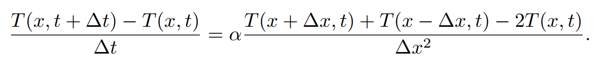
We cover the heat equation as example:
When the time and space derivatives are approximated in terms of finite differences, the PDE becomes the finite difference equation:

Slide 12
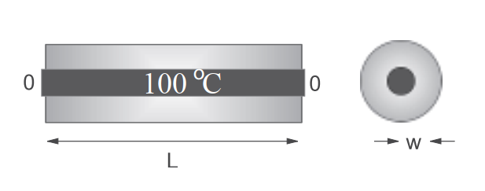
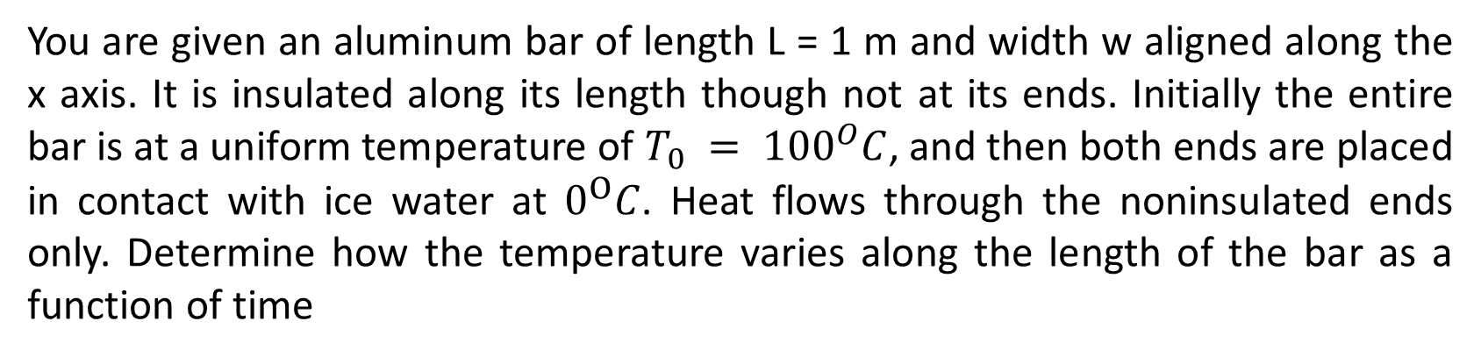
You are given an aluminum bar of length L = 1 m and width w aligned along the x axis. It is insulated along its length though not at its ends. Initially the entire bar is at a uniform temperature of $T_{0} = {100}^{O}C$, and then both ends are placed in contact with ice water at $0^{O}C$. Heat flows through the noninsulated ends only. Determine how the temperature varies along the length of the bar as a function of time

Slide 13
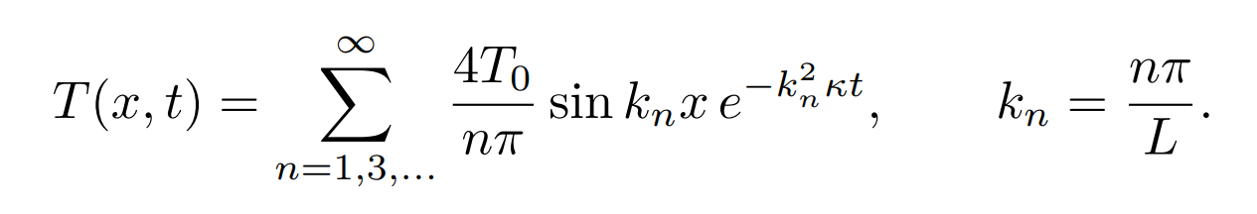
Analytic solution:

Slide 14
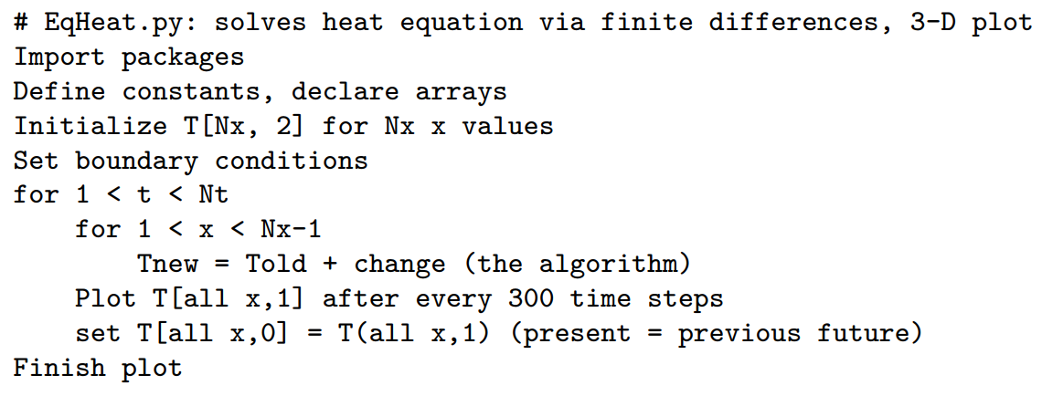
Numerical approach solution:

Slide 15
MONTE CARLO METHOD

Slide 16
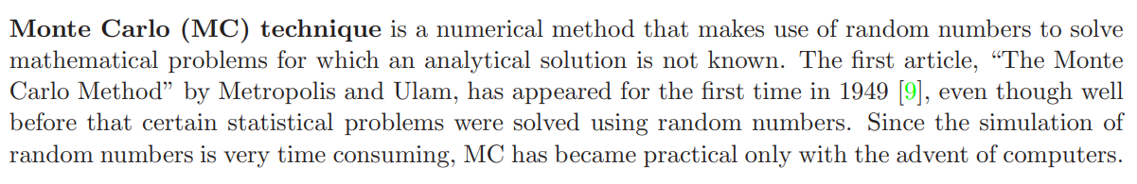
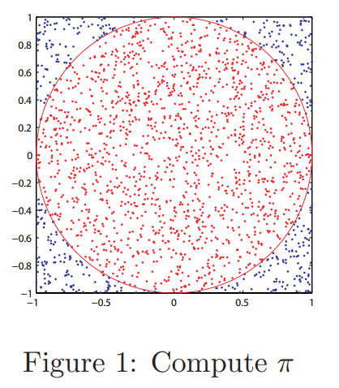
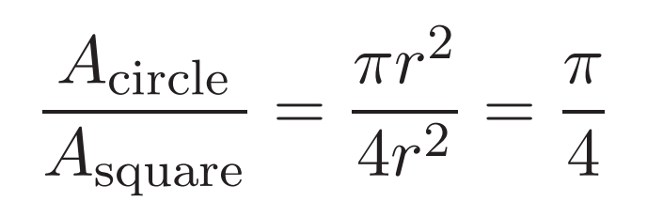
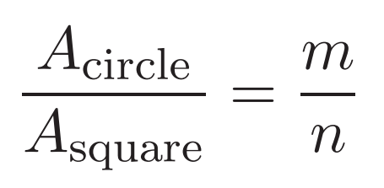

Slide 17
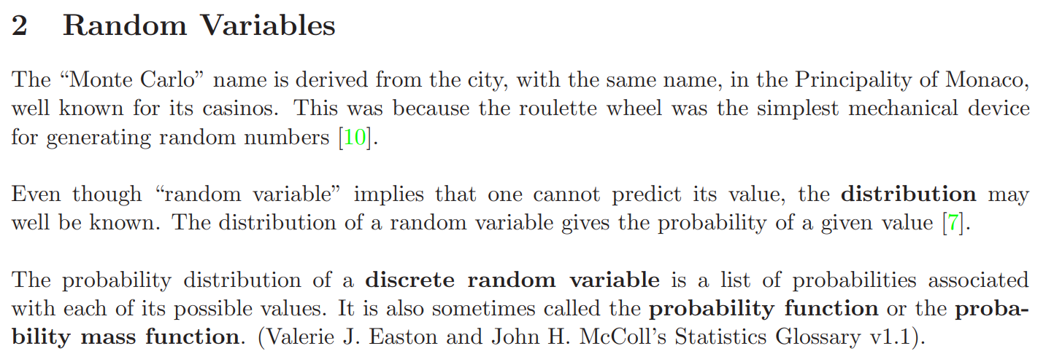

Slide 18
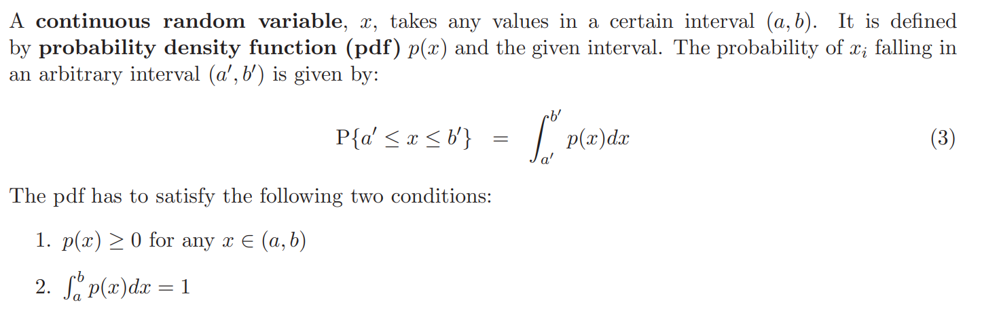

Slide 19
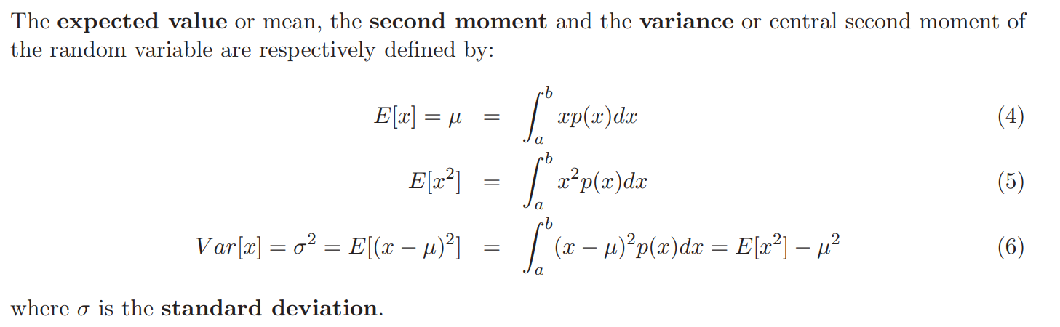

Slide 20

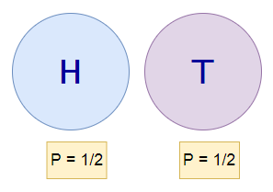
Coin Flip Example:
The probability of head for a fair coin is 1/2. However, is there any way we can prove it experimentally? In this example, we are going to use the Monte-Carlo method to simulate the coin-flipping iteratively 5000 times to find out why the probability of a head or tail is always 1/2. If we repeat this coin flipping many, many more times, then we can achieve higher accuracy on an exact answer for our probability value.

Slide 21
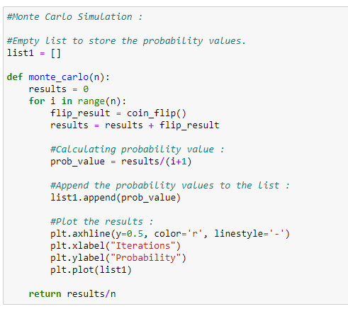
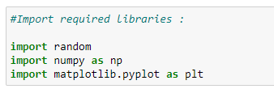
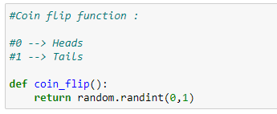
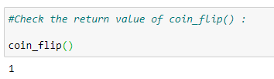
Coin Flip Example:

Slide 22
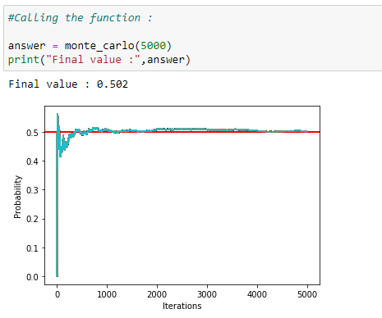
Coin Flip Example:

